Slide 1
Machine Learning
Lesson 2: Data Wrangling and Manipulation
Notes:
Trainer Notes:
1. Read title and subtitle
Estimated Duration (20 seconds)

Slide 2

By the end of this lesson, you will be able to:
Demonstrate data import and exploration using Python
Demonstrate different data wrangling techniques and their significance
Perform data manipulation in python using coercion, merging, concatenation,
and joins
Notes:
Trainer Notes
1. Read title and subtitle
2. Read each objective
Estimated Duration (30 seconds)

Slide 3
Data acquisition
Data exploration techniques
Data wrangling techniques
Data manipulation techniques
Typecasting
Notes:
Trainer Notes:
1. Read the slide title
2. Read each point
Estimated Duration (30 seconds)

Slide 4
Data Preprocessing
Topic 1: Data Exploration
Notes:
Trainer Notes:
1. Read out the slide title and subtitle
Estimated Duration (20 seconds)

Slide 5

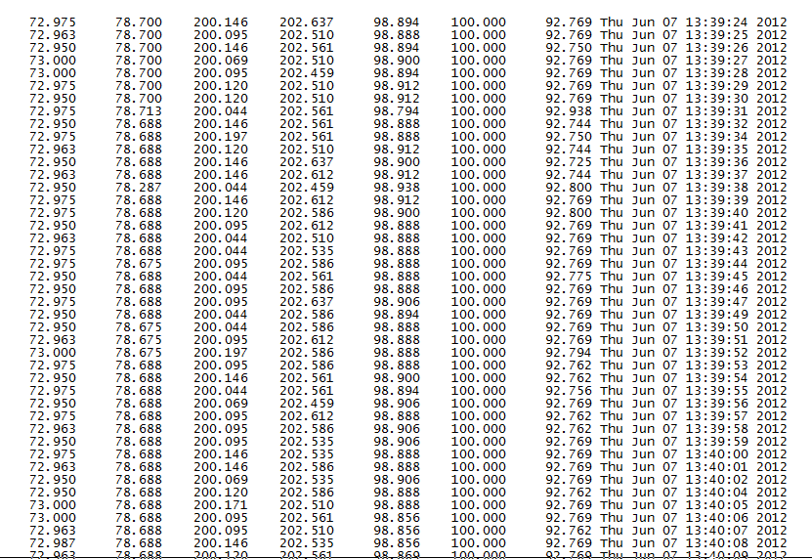
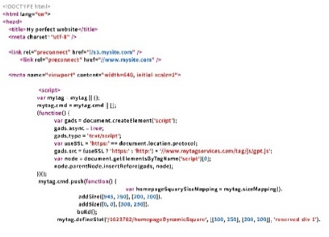
Loading .csv File in Python
Before starting with a dataset, the first step is to load the dataset. Below is the code for the same:
CSV File
Program Data
Program
Code
df = pandas.read_csv("/home/simpy/Datasets/BostonHousing.csv")
Path to file
Notes:
Trainer Notes:
1. Read the slide title
2. Read the line written in the blue box
3. Explain the following
a. Why importing file is always the first step to start
b. The significance of path to file
Estimated Duration (45 seconds)

Slide 6
Loading Data to .csv File
Below is the code for loading the data within an existing csv file:
Program
Program Data
CSV File
Code
df.to_csv("/home/simpy/Datasets/BostonHousing.csv")
Path to file
Notes:
Trainer Notes:
1. Read the slide title
2. Read the line written in the blue box
3. Explain the following
a. The significance of loading data to csv file specifying the path to file
Estimated Duration (45 seconds)

Slide 7
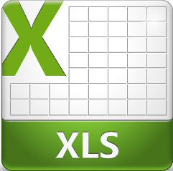
Loading .xlsx File in Python
Below is the code for loading an xlsx file within python:
XLS File
Program Data
Program
Code
df = pandas.read_excel("/home/simpy/Datasets/BostonHousing.xlsx")
Notes:
Trainer Notes:
1. Read the slide title
2. Read the line written in the blue box
3. Explain the following
a. Just as a csv file, explain the same for xlsx file
Estimated Duration (45 seconds)

Slide 8
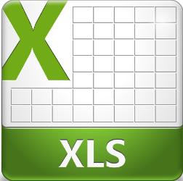
Loading Data to .xlsx File
Below is the code for loading program data into an existing xlsx file:
Program
Program Data
XLS File
Code
df.to_excel("/home/simpy/Datasets/BostonHousing.xlsx")
Notes:
Trainer Notes:
1. Read the slide title
2. Read the line written in the blue box
3. Explain the following
a. Just as a csv file, explain the same for xlsx file
Estimated Duration (45 seconds)

Slide 9
Demo
Data Exploration
Duration: 5 mins.
Problem Statement: Extract data from the given SalaryGender CSV file and store the data from each column in a separate NumPy array.
Objective: Import the dataset (csv) in/from your Python notebook to local system.
Access: Click on the Labs tab on the left side panel of the LMS. Copy or note the username and password that are generated. Click on the Launch Lab button. On the page that appears, enter the username and password in the respective fields, and click Login.
Notes:
Trainer Notes:
1. Read the slide title
2. Read out the text written in the problem statement, objective, access
3. Perform the above demo in python by downloading SalaryGender.csv file and explain the functioning of each step
4. Also, ask the learner to perform the demo simultaneously on their system
Estimated Duration (1 minute)

Slide 10
Data Exploration Techniques
Dimensionality Check
The shape attribute returns a two-item tuple (number of rows and the number of columns) for the data frame. For a Series, it returns a one-item tuple.
Type of Dataset
Slicing and Indexing
Code
df.shape
Identifying Unique Elements
Value Extraction
Feature Mean
Feature Median
Feature Mode
Notes:
Trainer Notes:
1. Read the slide title
2. Read out the text
3. Explain the following
How dimensionality check helps
Perform the above demo in python using Mt cars dataset
A scenario where dimensionality check helps to simplify a problem
Estimated Duration (45 seconds)

Slide 11
Data Exploration Techniques (Contd.)
Dimensionality Check
You can use the type ( ) in python to return the type of object.
Type of Dataset
Checking the type of data frame:
Slicing and Indexing
Code
Identifying Unique Elements
type(df)
Value Extraction
Checking the type of a column (çhas) within a data frame:
Feature Mean
Code
Feature Median
df['chas'].dtype
Feature Mode
Notes:
Trainer Notes:
1. Read the slide title
2. Read out the text in the first line
3. Explain the following
Significance of checking the type of dataset
Perform the above demo in python using Mt cars dataset
Estimated Duration (45 seconds)

Slide 12
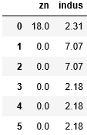
Data Exploration Techniques (Contd.)
Dimensionality Check
You can use the : operator with the start index on left and end index on right of it to output the corresponding slice.
Type of Dataset
list = [1,2,3,4,5]
Slicing a list:
Slicing and Indexing
Code
Identifying Unique Elements
list[1:3]
Value Extraction
Slicing a Data frame (df) using iloc indexer:
Feature Mean
Code
df.iloc[:,1:3]
Feature Median
Feature Mode
Notes:
Trainer Notes:
1. Read the slide title
2. Read out the text in the first line
3. Explain the following
Significance of slicing and indexing
Perform the above demo in python using Mt cars dataset
The above slicing techniques using ‘loc’ function in python
Slicing by passing column names directly
Estimated Duration (1 minute)

Slide 13
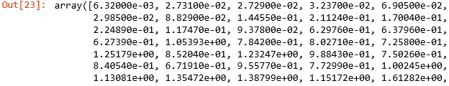
Data Exploration Techniques (Contd.)
Dimensionality Check
Using unique ( ) on the column of interest will return a numpy array with unique values of the column.
Type of Dataset
Extracting all unique values out of ‘’crim” column:
Slicing and Indexing
Code
Identifying Unique Elements
df['crim'].unique()
Value Extraction
Feature Mean
Feature Median
Feature Mode
Notes:
Trainer Notes:
1. Read the slide title
2. Read out the text in the first line
3. Explain the following
Significance of unique elements in data wrangling
Perform the above demo in python using Mt cars dataset
Estimated Duration (45 seconds)

Slide 14
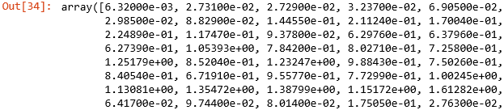
Data Exploration Techniques (Contd.)
Dimensionality Check
Using value ( ) on the column of interest will return a numpy array with all the values of the column.
Type of Dataset
Extracting values out of ‘’crim” column:
Slicing and Indexing
Code
Identifying Unique Elements
df['crim’].values()
Value Extraction
Feature Mean
Feature Median
Feature Mode
Notes:
Trainer Notes:
1. Read the slide title
2. Read out the text in the first line
3. Explain the following
Significance of values( ) in Python
Perform the above demo in python using Mt cars dataset
Estimated Duration (45 seconds)

Slide 15
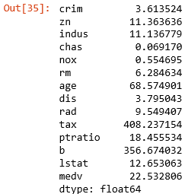
Data Exploration Techniques (Contd.)
Dimensionality Check
Using mean( ) on the data frame will return mean of the data frame across all the columns.
Type of Dataset
Code
Slicing and Indexing
df.mean()
Identifying Unique Elements
Value Extraction
Feature Mean
Feature Median
Feature Mode
Notes:
Trainer Notes:
1. Read the slide title
2. Read out the text in the first line
3. Explain the following
A theoretical overview of mean and its significance in data wrangling
Perform the above demo in python using Mt cars dataset
How to extract means with respect to a single feature in python
Estimated Duration (1 minute)

Slide 16
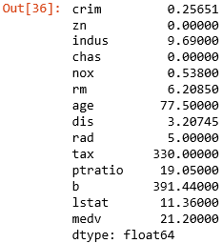
Data Exploration Techniques (Contd.)
Dimensionality Check
Using median( ) on the data frame will return median values of the data frame across all the columns.
Type of Dataset
Code
Slicing and Indexing
df.median()
Identifying Unique Elements
Value Extraction
Feature Mean
Feature Median
Feature Mode
Notes:
Trainer Notes:
1. Read the slide title
2. Read out the text in the first line
3. Explain the following
A theoretical overview of median and its significance in data wrangling
Perform the above demo in python using Mt cars dataset
How to extract median with respect to a single feature in python
Estimated Duration (1 minute)

Slide 17
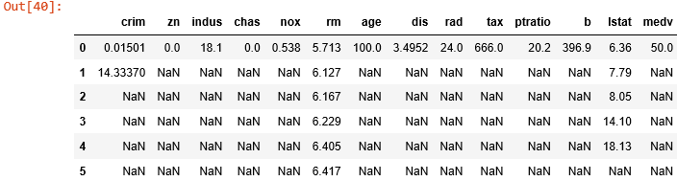
Data Exploration Techniques (Contd.)
Dimensionality Check
Using mode( ) on the data frame will return mode values of the data frame across all the columns, rows with axis=0 and axis = 1, respectively.
Type of Dataset
Code
Slicing and Indexing
df.mode(axis=0)
Identifying Unique Elements
Value Extraction
Feature Mean
Feature Median
Feature Mode
Notes:
Trainer Notes:
1. Read the slide title
2. Read out the text in the first line
3. Explain the following
A theoretical overview of mode and its significance in data wrangling
Perform the above demo in python using Mt cars dataset
How to extract mode with respect to a single feature in python
Estimated Duration (1 minute)

Slide 18
Let’s now consider multiple features and understand the effect of one over other with respect to correlation (using seaborn)
Notes:
Trainer Notes:
Read out the line
Estimated Duration (20 seconds)

Slide 19


Seaborn is a library for making attractive and informative statistical graphics in Python. It is built on top of matplotlib and integrated with the PyData Stack, including support for numpy and pandas data structures, and statistical routines.
©Simplilearn. All rights reserved
Notes:
Trainer Notes:
Read out the text in the yellow box
Explain the following
What is seaborn library
How it is different from another visualization library like matplotlib
Why it is extensively used
Importing and installing seaborn library package in local system
Estimated Duration (1 minute)

Slide 20
Plotting a Heatmap with Seaborn
Below is the code for plotting a heatmap within Python:
Code
import matplotlib.pyplot as plt
import seaborn as sns
correlations = df.corr()
sns.heatmap(data = correlations,square = True, cmap = "bwr")
plt.yticks(rotation=0)
plt.xticks(rotation=90)
Rectangular dataset (2D dataset that can be coerced into an ndarray)
Matplotlib colormap name or object, or list of colors
If True, set the Axes aspect to “equal” so each cell will be square-shaped
Notes:
Trainer Notes:
1. Read the slide title
2. Explain the following
What is correlation (statistically)
Why heatmap is used for plotting correlation
Perform the above demo in python using Mt cars dataset
Estimated Duration (45 seconds)

Slide 21
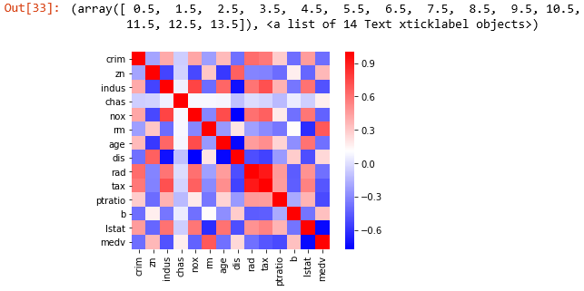
Plotting a Heatmap with Seaborn (Contd.)
Below is the heatmap obtained, where, approaching red colour means maximum correlation and approaching blue means minimal correlation.
Minimum correlation
Maximum correlation
Notes:
Trainer Notes:
Explain the following
Significance of colours in Heatmap
What the above array values in the output indicate
Estimated Duration (30 seconds)

Slide 22
Demo
Data Exploration
Duration: 15 mins.
Problem Statement: Suppose you are a public school administrator. Some schools in your state of Tennessee are performing below average academically. Your superintendent under pressure from frustrated parents and voters approached you with the task of understanding why these schools are under-performing. To improve school performance, you need to learn more about these schools and their students, just as a business needs to understand its own strengths and weaknesses and its customers. The data includes various demographic, school faculty, and income variables.
Objective: Perform exploratory data analysis which includes: determining the type of the data, correlation analysis over the same. You need to convert the data into useful information:
Read the data in pandas data frame
Describe the data to find more details
Find the correlation between ‘reduced_lunch’ and ‘school_rating’
Access: Click on the Labs tab on the left side panel of the LMS. Copy or note the username and password that are generated. Click on the Launch Lab button. On the page that appears, enter the username and password in the respective fields, and click Login.
Notes:
Trainer Notes:
1. Read the slide and sub-title
2. Read the Problem statement and explain the objective
3. Explaining Access: is not required
Estimated Duration (2 minutes)

Slide 23
Practice
Data Exploration Duration: 15 mins.
Problem Statement: Mtcars, an automobile company in Chambersburg, United States has recorded the production of its cars within a dataset. With respect to some of the feedback given by their customers they are coming up with a new model. As a result of it they have to explore the current dataset to derive further insights out if it.
Objective: Import the dataset, explore for dimensionality, type and average value of the horsepower across all the cars. Also, identify few of mostly correlated features which would help in modification.
Note: This practice is not graded. It is only intended for you to apply the knowledge you have gained to solve real-world problems.
Access: Click on the Labs tab on the left side panel of the LMS. Copy or note the username and password that are generated. Click on the Launch Lab button. On the page that appears, enter the username and password in the respective fields, and click Login
Notes:
Trainer Notes:
1. Read the slide and subtitle
2. Read the Problem statement and explain the objective
Estimated Duration (2 minutes)

Slide 24
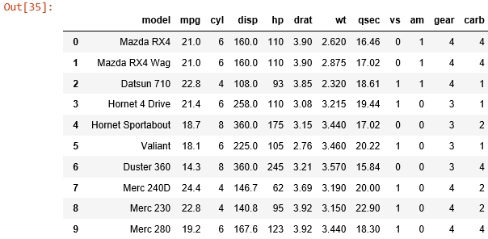
Data Import
The first step is to import the data as a part of exploration.
Code
df1 = pandas.read_csv(“mtcars.csv“)
Notes:
Trainer Notes:
Read the slide title
Read out the line written in the blue box
Explain what is data import and how it works
Estimated Duration (30 seconds)

Slide 25
Data Exploration
The shape property is usually used to get the current shape of an array/df.
Dimensionality Check
Code
df1.shape
Type of Dataset
Identifying mean value
Notes:
Trainer Notes:
Read out the slide title
Read out the name written in the yellow box
Read out the line written in the first blue box
Explain how dimensional check works
Estimated Duration (45 seconds)

Slide 26
Data Exploration
type(), returns type of the given object.
Dimensionality Check
Code
type(df1)
Type of Dataset
Identifying mean value
Notes:
Trainer Notes:
Read out the name written in the yellow box
Read out the line written in the first blue box
Explain how type of dataset works
Estimated Duration (30 seconds)

Slide 27
Data Exploration
mean( ) function can be used to calculate mean/average of a given list of numbers.
Dimensionality Check
Code
df1[‘hp’].mean()
Type of Dataset
Identifying mean value
Notes:
Trainer Notes:
Read out the name written in the yellow box
Read out the line written in the first blue box
Explain how identifying mean value works
Estimated Duration (30 seconds)

Slide 28
Identifying Correlation Using a Heatmap
Heatmap function in seaborn is used to plot the correlation matrix.
Code
import matplotlib.pyplot as plt
import seaborn as sns
correlations = df1.corr()
sns.heatmap(data = correlations,square = True, cmap = “viridis")
plt.yticks(rotation=0)
plt.xticks(rotation=90)
Notes:
Trainer Notes:
Read out the slide title
Read out the line written in the blue box
Explain how using a heatmap we can identify correlation
Estimated Duration (45 seconds)

Slide 29
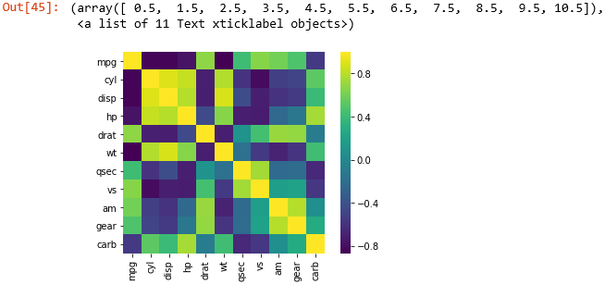
Identifying Correlation Using a Heatmap
Graphical representation of data where the individual values contained in a matrix are represented in colors.
From the adjacent map, you can clearly see that cylinder (cyl) and displacement (disp) are the most correlated features.
Notes:
Trainer Notes:
Read out the line written in the blue box
Explain the graph
Estimated Duration (30 seconds)

Slide 30
Data Preprocessing
Topic 2: Data Wrangling
Notes:
Trainer Notes:
Read the slide title and the subtitle
Estimated Duration (20 seconds)

Slide 31
Data Wrangling
The process of manually converting or mapping data from one raw format into another format is called data wrangling. This includes munging and data visualization.
Discovering
Structuring
Different Tasks in Data Wrangling
Cleaning
Enrichment
Validating
Notes:
Trainer Notes:
Read the slide title
Read out the line written in the orange box and explain what is data wrangling
Explain the different tasks in data wrangling
Estimated Duration (1 minute)

Slide 32
Need of Data Wrangling
Following are the problems that can be avoided with wrangled data:
Missing data, a very common problem
Presence of noisy data (erroneous data and outliers)
Inconsistent data
Develop a more accurate model
Prevent data leakage
Notes:
Trainer Notes:
Read the slide title
Read out the line written in the blue box
Read out the points
Estimated Duration (30 seconds)

Slide 33
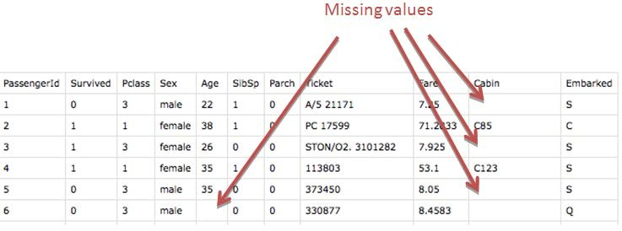
Missing Values in a Dataset
Consider a random dataset given below, illustrating missing values.
Notes:
Trainer Notes:
Read the slide title
Explain the following
How missing values in a dataset look like
What causes missing values
Estimated Duration (45 seconds)

Slide 34
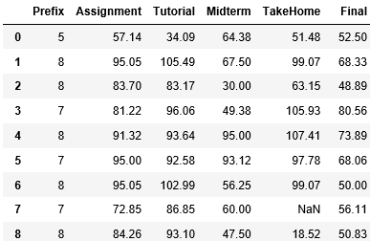
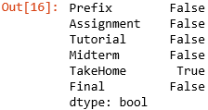
Missing Value Detection
Consider a dataset below, imported as df1 within Python, having some missing values.
Code
Detecting missing values
df1.isna().any()
Notes:
Trainer Notes:
Read the slide title
Explain the following
How missing values can be detected
Use of isna( ). any ( ) in python
Perform the above demo in python using class-grades.csv dataset
What does TRUE and FALSE in the output specify
Estimated Duration (1 minute)

Slide 35

Missing Value Treatment
Code
Mean Imputation: Replace the missing value with variable’s mean
from sklearn.preprocessing import Imputer
mean_imputer = Imputer(missing_values=np.nan,strategy='mean',axis=1)
mean_imputer = mean_imputer.fit(df1)
imputed_df = mean_imputer.transform(df1.values)
df1 = pd.DataFrame(data=imputed_df,columns=cols)
df1
Notes:
Trainer Notes:
Read the slide title
Explain the following
Imputer function and its significance
Use of mean imputation
How mean imputation cures the missing value problem
Perform the above demo in python using class-grades.csv dataset
Estimated Duration (45 seconds)

Slide 36


Missing Value Treatment (Contd.)
Code
Mean Imputation: Replace the missing value with variable’s mean
from sklearn.preprocessing import Imputer
median_imputer=Imputer(missing_values=np.nan,strategy=‘median',axis=1)
median_imputer = median_imputer.fit(df1)
imputed_df = median_imputer.transform(df1.values)
df1 = pd.DataFrame(data=imputed_df,columns=cols)
df1
Median Imputation: Replace the missing value with variable’s median
Note: Mean imputation/Median imputation is again model dependent and is valid only on numerical data.
Notes:
Trainer Notes:
Read the slide title
Explain the following
Use of median imputation
How median imputation cures the missing value problem
Also, the scenarios where mean/median imputations are useful
Perform the above demo in python using class-grades.csv dataset
Estimated Duration (45 seconds)

Slide 37
Outlier Values in a Dataset
5
4
OUTLIER?
An outlier is a value that lies outside the usual observation of values.
3
FREQUENCY
2
1
0
7.0
7.5
8.0
8.5
9.0
9.5
10.0
10.5
11.0
11.5
12.0
12.5
13.0
13.5
14.0
14.5
15.0
x MIDPOINT
13
12
11
10
Y3
9
8
7
6
5
5.0
7.5
10.0
12.5
15.0
X1
Note: Outliers skew the data when you are trying to do any type of average.
Notes:
Trainer Notes:
Read the slide title
Explain the following
What are outlier values
How outlier affects a model
What are the possible causes of outlier values
Estimated Duration (45 seconds)

Slide 38
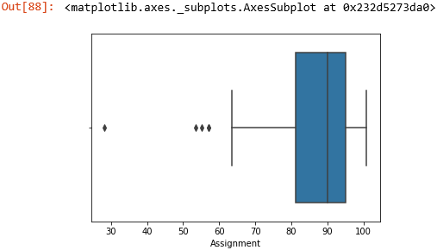
Dealing with an Outlier
Detect any outlier in the first column of df1
Outlier Detection
Code
import seaborn as sns
sns.boxplot(x=df1['Assignment'])
Outlier Treatment
Outliers: Values < 60
Notes:
Trainer Notes:
Read the slide title
Explain the following
How to detect an outlier using boxplot
Explain the boxplot in detail
Explain quartiles, inter-quartiles in boxplot
Estimated Duration (45 seconds)

Slide 39
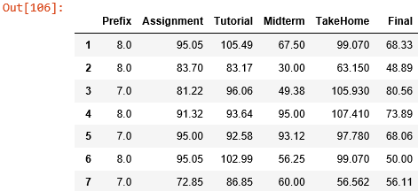
Dealing with an Outlier
Create a filter based on the boxplot obtained and apply the filter to the data frame
Outlier Detection
Code
filter=df1['Assignment'].values>60
df1_outlier_rem=df1[filter]
df1_outlier_rem
Outlier Treatment
Notes:
Trainer Notes:
Read the slide title
Explain the following
Why outlier treatment is necessary
Why we are creating filter here
Other methods of outlier treatment like moving window, etc.,
Estimated Duration (45 seconds)

Slide 40
Demo
Duration: 15 mins.
Data Wrangling
Problem Statement: Load the load_diabetes datasets internally from sklearn and check for any missing value or outlier data in the ‘data’ column. If any irregularities found treat them accordingly.
Objective: Perform missing value and outlier data treatment.
Access: Click on the Labs tab on the left side panel of the LMS. Copy or note the username and password that are generated. Click on the Launch Lab button. On the page that appears, enter the username and password in the respective fields, and click Login.
Notes:
Trainer Notes:
1. Read the slide and subtitle
2. Read the Problem statement and explain the objective
3. Explaining Access: is not required
Estimated Duration ( 2 minutes )

Slide 41
Practice
Data Wrangling Duration: 5 mins.
Problem Statement: Mtcars, the automobile company in the United States have planned to rework on optimizing the horsepower of their cars, as most of the customers feedbacks were centred around horsepower. However, while developing a ML model with respect to horsepower, the efficiency of the model was compromised. Irregularity might be one of the causes.
Objective: Check for missing values and outliers within the horsepower column and remove them.
Note: This practice is not graded. It is only intended for you to apply the knowledge you have gained to solve real-world problems.
Access: Click on the Labs tab on the left side panel of the LMS. Copy or note the username and password that are generated. Click on the Launch Lab button. On the page that appears, enter the username and password in the respective fields, and click Login.
Notes:
Trainer Notes:
1. Read the slide and subtitle
2. Read the Problem statement and explain the objective
Estimated Duration ( 2 minutes )

Slide 42
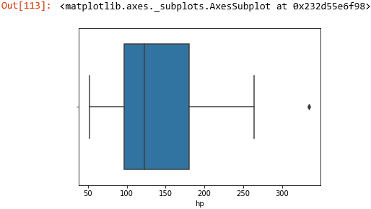
Check for Irregularities
Check for missing values
Check for Outliers
Code
Code
df1['hp'].isna().any()
sns.boxplot(x=df1['hp'])
Outlier
Notes:
Trainer Notes:
Read the slide title
Explain how check for irregularities work
Explain check for missing values
Explain check for outliers
Estimated Duration (45 seconds)

Slide 43
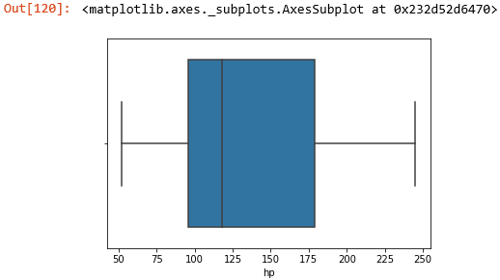
Outlier Treatment
Data with hp>250 is the outlier data. Therefore, you can filter it accordingly.
Code
filter = df1['hp']<250
df1_out_rem = df1[filter]
sns.boxplot(x=df2_out_rem['hp'])
Outlier filtered data
Notes:
Trainer Notes:
Read the slide title
Explain the outlier treatment and outlier data.
Estimated Duration (30 seconds)

Slide 44
Data Preprocessing
Topic 3: Data Manipulation
Notes:
Trainer Notes:
1. Read the slide title and the subtitle
Estimated Duration (20 seconds)

Slide 45
Functionalities of Data Object in Python
A data object is a two-dimensional data structure, i.e., data is aligned in a tabular fashion in rows and columns.
head( )
tail( )
values( )
groupby( )
Concatenation
Merging
Notes:
Trainer Notes:
Read the slide title
Explain the following
What is a data object and why it is helpful
Why the above functionalities are being discussed
Estimated Duration (45 seconds)

Slide 46
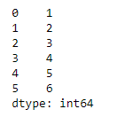
Functionalities of Data Object in Python (Contd.)
head( )
Head( ) returns the first n rows of the data structure
tail( )
Code
values( )
import pandas as pd import numpy as np df=pd.Series(np.arange(1,51)) print(df.head(6))
groupby( )
Concatenation
Merging
Notes:
Trainer Notes:
Explain the following
Significance of head ( )
Perform the above demo in python
Estimated Duration (30 seconds)

Slide 47
Functionalities of Data Object in Python (Contd.)
head( )
values( ) returns the actual data in the series of the array
tail( )
Code
values( )
import pandas as pd import numpy as np df=pd.Series(np.arange(1,51)) print(df.values)
groupby( )
Concatenation
Merging
Notes:
Trainer Notes:
Explain the following
Significance of values ( )
Perform the above demo in python
Estimated Duration (45 seconds)

Slide 48
Functionalities of Data Object using Python (Contd.)
head( )
The Data Frame is grouped according to the ‘Team’ and ‘ICC_Rank’ columns
Code
tail( )
import pandas as pd world_cup={'Team':['West Indies','West indies','India','Australia','Pakistan','Sri Lanka','Australia','Australia','Australia','Insia','Australia'], 'Rank':[7,7,2,1,6,4,1,1,1,2,1], 'Year':[1975,1979,1983,1987,1992,1996,1999,2003,2007,2011,2015]} df=pd.DataFrame(world_cup) print(df.groupby(['Team','Rank’]).groups)
values( )
groupby( )
Concatenation
Merging
Notes:
Trainer Notes:
Explain the following
Significance of group by ( ) with respect to the above code
Perform the above demo in python
Estimated Duration (45 seconds)

Slide 49
Functionalities of Data Object in Python (Contd.)
Concatenation combines two or more data structures.
head( )
Code
tail( )
import pandas world_champions={'Team':['India','Australia','West Indies','Pakistan','Sri Lanka’], 'ICC_rank':[2,3,7,8,4], 'World_champions_Year':[2011,2015,1979,1992,1996], 'Points':[874,787,753,673,855]} chokers={'Team':['South Africa','New Zealand','Zimbabwe'],'ICC_rank':[1,5,9], 'Points':[895,764,656]} df1=pandas.DataFrame(world_champions) df2=pandas.DataFrame(chokers) print(pandas.concat([df1,df2],axis=1))
values( )
groupby( )
Concatenation
Merging
Notes:
Trainer Notes:
Explain the following
What is concatenation
Significance of concate( ) with respect to the above code
Also what axis means in the code
Perform the above demo in python
Estimated Duration (1 minute)

Slide 50
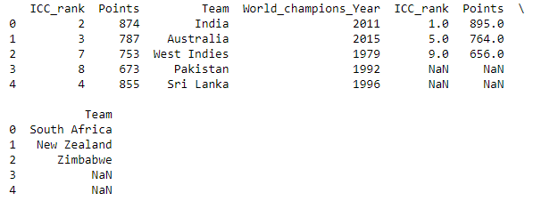
Functionalities of Data Object in Python (Contd.)
The concatenated output:
head( )
tail( )
values( )
groupby( )
Concatenation
Merging
Notes:
Trainer Notes:
Explain the following
a. Above concatenated output
Estimated Duration (30 seconds)

Slide 51
Functionalities of Data Object in Python (Contd.)
Merging is the Pandas operation that performs database joins on objects
head( )
Code
tail( )
import pandas champion_stats={'Team':['India','Australia','West Indies','Pakistan','Sri Lanka'], 'ICC_rank':[2,3,7,8,4], 'World_champions_Year':[2011,2015,1979,1992,1996], 'Points':[874,787,753,673,855]} match_stats={'Team':['India','Australia','West Indies','Pakistan','Sri Lanka'], 'World_cup_played':[11,10,11,9,8], 'ODIs_played':[733,988,712,679,662]} df1=pandas.DataFrame(champion_stats) df2=pandas.DataFrame(match_stats) print(df1) print(df2)
print(pandas.merge(df1,df2,on='Team'))
values( )
groupby( )
Concatenation
Merging
Notes:
Trainer Notes:
Explain the following
What is Merging
Significance of merge ( ) with respect to the above code
Also what on mean in the code
Perform the above demo in python
If Concatenation and merging are different, if yes then how
Scenarios where concatenation and merging produces same results
Estimated Duration (90 seconds)

Slide 52
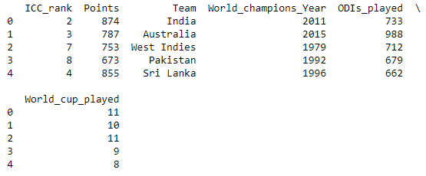
Functionalities of Data Object in Python (Contd.)
head( )
tail( )
values( )
groupby( )
Concatenation
The merged object contains all the columns of the data frames merged
Merging
Notes:
Trainer Notes:
Read the slide title
Explain the following
a. Merged output
Estimated Duration (30 seconds)

Slide 53
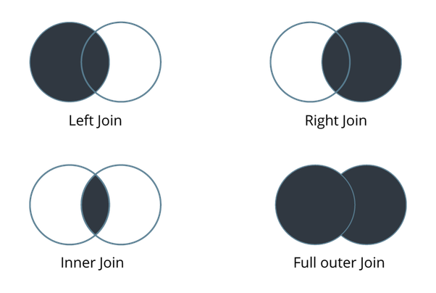
Different Types of Joins
Joins are used to combine records from two or more tables in a database. Below are the four most commonly used joins:
Left Join
Right Join
Inner Join
Full Outer Join
Notes:
Trainer Notes:
Read the slide title
Explain the following
What are joins with respect to set theory
Why joins are significant
Estimated Duration (30 seconds)

Slide 54
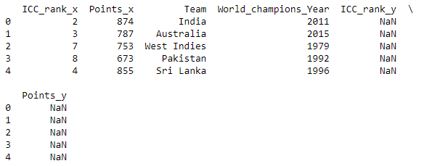
Left Join
Left Join
Code
import pandas world_champions={'Team':['India','Australia','West Indies','Pakistan','Sri Lanka'], 'ICC_rank':[2,3,7,8,4], 'World_champions_Year':[2011,2015,1979,1992,1996], 'Points':[874,787,753,673,855]} chokers={'Team':['South Africa','New Zealand','Zimbabwe'], 'ICC_rank':[1,5,9],'Points':[895,764,656]} df1=pandas.DataFrame(world_champions) df2=pandas.DataFrame(chokers) print(pandas.merge(df1,df2,on='Team',how='left'))
Returns all rows from the left table, even if there are no matches in the right table
Notes:
Trainer Notes:
Read the slide title
Explain the following
Left join and what it returns
Scenarios where left join might be helpful
Perform the above demo in python
Significance of ‘on’ and ‘how’ in the above code
Estimated Duration (45 seconds)

Slide 55
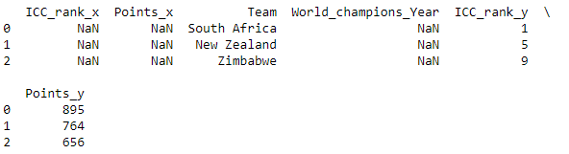
Right Join
Right Join
Code
import pandas world_champions={'Team':['India','Australia','West Indies','Pakistan','Sri Lanka'], 'ICC_rank':[2,3,7,8,4], 'World_champions_Year':[2011,2015,1979,1992,1996], 'Points':[874,787,753,673,855]} chokers={'Team':['South Africa','New Zealand','Zimbabwe'],'ICC_rank':[1,5,9],'Points':[895,764,656]} df1=pandas.DataFrame(world_champions) df2=pandas.DataFrame(chokers) print(pandas.merge(df1,df2,on='Team',how=‘right'))
Preserves the unmatched rows from the second (right) table, joining them with a NULL in the shape of the first (left) table
Notes:
Trainer Notes:
Read the slide title
Explain the following
Right join and what it returns
Scenarios where right join might be helpful
Perform the above demo in python
Significance of ‘on’ and ‘how’ in the above code
Estimated Duration (45 seconds)

Slide 56

Inner Join
Inner Join
Code
import pandas world_champions={'Team':['India','Australia','West Indies','Pakistan','Sri Lanka'], 'ICC_rank':[2,3,7,8,4], 'World_champions_Year':[2011,2015,1979,1992,1996], 'Points':[874,787,753,673,855]} chokers={'Team':['South Africa','New Zealand','Zimbabwe'],'ICC_rank':[1,5,9],'Points':[895,764,656]} df1=pandas.DataFrame(world_champions) df2=pandas.DataFrame(chokers) print(pandas.merge(df1,df2,on='Team',how=‘inner'))
Selects all rows from both participating tables if there is a match between the columns
Notes:
Trainer Notes:
Read the slide title
Explain the following
Inner join and what it returns
Scenarios where inner join might be helpful
Perform the above demo in python
Significance of ‘on’ and ‘how’ in the above code
Estimated Duration (45 seconds)

Slide 57
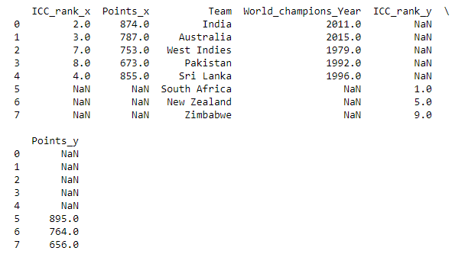
Full Outer Join
Full Outer Join
Code
import pandas world_champions={'Team':['India','Australia','West Indies','Pakistan','Sri Lanka'], 'ICC_rank':[2,3,7,8,4], 'World_champions_Year':[2011,2015,1979,1992,1996], 'Points':[874,787,753,673,855]} chokers={'Team':['South Africa',’New Zealand','Zimbabwe'],'ICC_rank':[1,5,9],'Points':[895,764,656]} df1=pandas.DataFrame(world_champions) df2=pandas.DataFrame(chokers) print(pandas.merge(df1,df2,on='Team',how=‘outer'))
Returns all records when there is a match in either left (table1) or right (table2) table records
Notes:
Trainer Notes:
Read the slide title
Explain the following
Full outer join and what it returns
Scenarios where outer join might be helpful
Perform the above demo in python
Significance of ‘on’ and ‘how’ in the above code
Estimated Duration (45 seconds)

Slide 58
Typecasting
It converts the data type of an object to the required data type.
string( )
Returns string from any numeric object or converts any number to string
Int( )
Returns an integer object from any number or string.
float( )
Returns a floating-point number from a number or a string
Notes:
Trainer Notes:
Read the slide title
Explain the following
Why is typecasting important
A scenario where typecasting does the task easier
Discuss each of the above typecasting functions
Estimated Duration (45 seconds)

Slide 59
Typecasting Using Int, float and string( )
Few typecasted data types
Code
Code
int(12.32)
float(23)
Code
int(12.32)
Code
Code
int(‘43’)
float('21.43')
Notes:
Trainer Notes:
Read the slide title
Explain the following
a. Perform the above demos in python and show their types
Estimated Duration (45 seconds)

Slide 60
Demo
Data Manipulation
Duration: 10 mins.
Problem Statement: As a macroeconomic analyst at the Organization for Economic Cooperation and Development (OECD), your job is to collect relevant data for analysis. It looks like you have three countries in the north_america data frame and one country in the south_america data frame. As these are in two separate plots, it's hard to compare the average labor hours between North America and South America. If all the countries were into the same data frame, it would be much easier to do this comparison.
Objective: Demonstrate concatenation.
Access: Click on the Labs tab on the left side panel of the LMS. Copy or note the username and password that are generated. Click on the Launch Lab button. On the page that appears, enter the username and password in the respective fields, and click Login.
Notes:
Trainer Notes:
Explain the above scenario
Perform the above demo in python using the datasets: north_America_2000_2010 and south_america_2000_2010 and corresponding .ipynb file
Estimated Duration (30 seconds)

Slide 61
Practice
Data Manipulation Duration: 10 mins.
Problem Statement: SFO Public Department - referred to as SFO has captured all the salary data of its employees from year 2011-2014. Now in 2018 the organization is facing some financial crisis. As a first step HR wants to rationalize employee cost to save payroll budget. You have to do data manipulation and answer the below questions:
How much total salary cost has increased from year 2011 to 2014?
Who was the top earning employee across all the years?
Objective: Perform data manipulation and visualization techniques
Note: This practice is not graded. It is only intended for you to apply the knowledge you have gained to solve real-world problems.
Access: Click on the Labs tab on the left side panel of the LMS. Copy or note the username and password that are generated. Click on the Launch Lab button. On the page that appears, enter the username and password in the respective fields, and click Login.
Notes:
Trainer Notes:
Explain the following:
The above scenario
Ask the learners to perform the above demo in python downloading the ‘salaries.csv’ file.
Estimated Duration (30 seconds)

Slide 62
Now, you are able to:
Demonstrate data import and exploration using Python
Demonstrate different data wrangling techniques and their significance
Perform data manipulation in python using coercion, merging, concatenation, and joins
Notes:
Trainer Notes:
1. Read title and subtitle
2. Read each objective
Estimated Duration: 30 seconds

Slide 63
©Simplilearn. All rights reserved

Slide 64
Which of the following plots can be used to detect an outlier?
1
Boxplot
Histogram
Scatter plot
All of the above

Slide 65
Which of the following plots can be used to detect an outlier?
1
Boxplot
Histogram
Scatter plot
All of the above
d . All of the above
All the above plots can be used to detect an outlier.

Slide 66
What is the output of the below Python code?
import numpy as np percentiles = [98, 76.37, 55.55, 69, 88] first_subject = np.array(percentiles) print first_subject.dtype
2
float32
float
int32
float64

Slide 67
What is the output of the below Python code?
import numpy as np
percentiles = [98, 76.37, 55.55, 69, 88]
first_subject = np.array(percentiles)
print first_subject.dtype
2
float32
float
int32
float64
d. float64
Float64’s can represent numbers much more accurately than other floats and has more storage capacity.

Slide 68
Lesson-End Project
Duration: 20 mins.
Problem Statement: From the raw data below create a data frame:
'first_name': ['Jason', 'Molly', 'Tina', 'Jake', 'Amy'], 'last_name': ['Miller', 'Jacobson', ".", 'Milner', 'Cooze'],
'age': [42, 52, 36, 24, 73], 'preTestScore': [4, 24, 31, ".", "."],'postTestScore': ["25,000", "94,000", 57, 62, 70]
Objective: Perform data processing on raw data:
Save the data frame into a csv file as project.csv
Read the project.csv and print the data frame
Read the project.csv without column heading
Read the project.csv and make the index columns as 'First Name’ and 'Last Name'
Print the data frame in a Boolean form as True or False. True for Null/ NaN values and false for non-null values
Read the data frame by skipping first 3 rows and print the data frame
Access: Click the Labs tab in the left side panel of the LMS. Copy or note the username and password that are generated. Click the Launch Lab button. On the page that appears, enter the username and password in the respective fields and click Login.
Notes:
Trainer Notes: Explain the project to the learners and instruct them to perform it after the lesson.

